Slide 1
LIFESTYLE STORE
Detailed Developer Report

Slide 2
SECURITY STATUS – EXTREMELY VULNERABLE
Hackers can steal all the records of Lifestyle store(SQLi)
Hacker can take control of complete server including View, Add, Edit, Delete files and folders.(shell upload and weak passwords)
Hacker can change source code of application to host malware, phishing pages or even explicit content.(Shell upload)
Hacker can see details of any customer.(IDOR)
Hacker can easily access or bypass admin account authentication.(bruteforcing)
Hacker can get access to seller details and login into the website using customer of the month usernames (PII).
Hacker can change the password , confirm order and remove item of customer(CSRF)

Slide 3
VULNERABILITY STATISTIC
CRITICAL
SEVERE
MODERATE
14
10
7
LOW
5

Slide 4
VULNERABILITIES:-
S.NO. | VULNERABILITY | SEVERITY | COUNT
1 | SQL Injection | CRITICAL | 3
2 | Access to admin panel | CRITICAL | 1
3 | Arbitrary file upload | CRITICAL | 2
4 | Account takeover by otp bypass | CRITICAL | 1
5 | CSRF | CRITICAL | 3
6 | Reflected XSS | SEVERE | 1
7 | Stored XSS | SEVERE | 1
8 | Common password | SEVERE | 1

Slide 5
VULNERABILITIES:-
S.NO. | VULNERABILITY | SEVERITY | COUNT
9 | Component with known vulnerability | SEVERE | 3
10 | Server misconfiguration | MODERATE | 1
11 | IDOR | MODERATE | 4
12 | Directory Listings | MODERATE | 5
13 | Personal Information leakage | LOW | 2
14 | Client side and server side validation bypass | LOW | 1
15 | Default error display | LOW | 1
16 | Open redirection | LOW | 2

Slide 6
1. SQL Injection
SQL Injection(Critical)
Below mentioned URL in the T-shirt/socks/shoes module is vulnerable to SQL injection attack
Affected URL :
•http://52.66.55.190/products.php?cat=1
Affected Parameters :
•cat (GET parameter)
Payload:
•cat =1’
Affected URL :
•http://52.66.55.190/products.php?s=shocks
Affected Parameters :
•s (GET parameter)
Payload:
•s=socks'

Slide 7
1. SQL Injection
SQL Injection(Critical)
Here are other similar SQLi in the application
Affected URL :
•http://52.66.55.190/products.php?cat=2
•http://52.66.55.190/products.php?cat=3

Slide 8
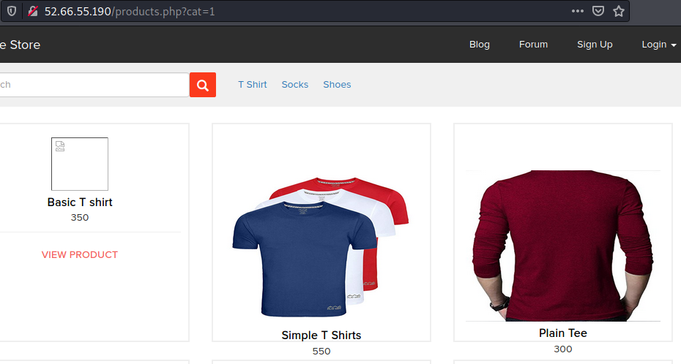
Observation•
Navigate to T-Shirt , Shocks or Shoes tab where you will see number of T-shirts , Shocks or Shoes respectively. Notice the GET parameter CAT in the URL:

Slide 9
Observation
•We apply single quote in cat parameter: products.php?cat=1’ and we get complete MySQL error:

Slide 10
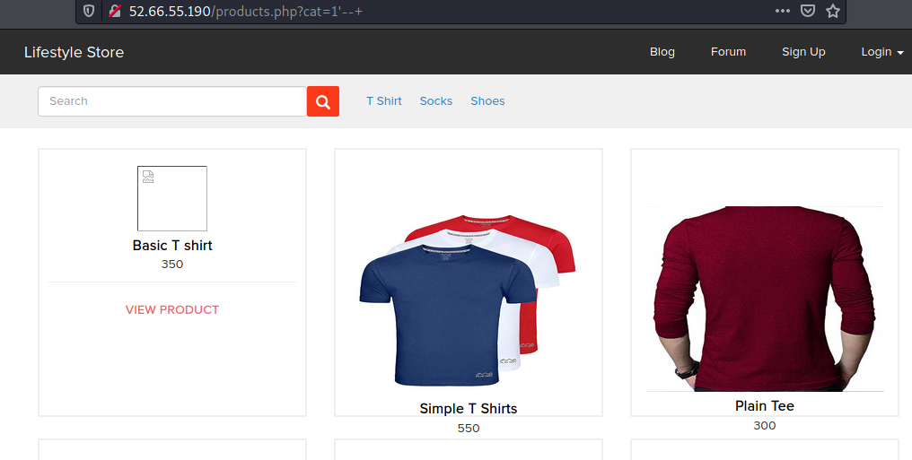
Observation
•We then put --+ : products.php?cat=1’--+ and we error is removed confirming SQL injection
•Now hacker can inject sqlor use usesqlmapto get access to the database

Slide 11
Observation
• We then put --+ : products.php?cat=1’--+ and we error is removed confirming SQL injection
• Now hacker can inject sql manually or use use sqlmap to get access to the database.

Slide 12
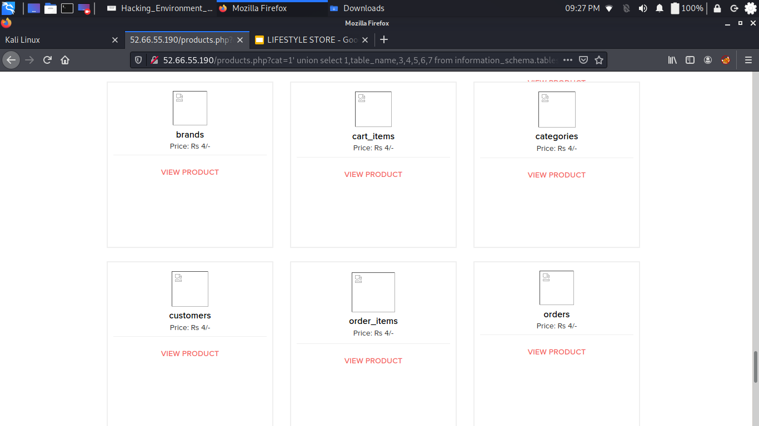
PoC: Attacker can dump arbitrary data
Manual approach have been done to find table name existence using following commands in url:
http://52.66.55.190/products.php?cat=1'union select 1,table_name,3,4,5,6,7 from information_schema.tables where table_schema="hacking_training_project"--+
No. of databases
Information_schema
hacking_training_project
No. of tables
•brands
•cart_items
•categories
•customers
•order_items
•orders
•product_reviews
•products
•sellers
•user

Slide 13
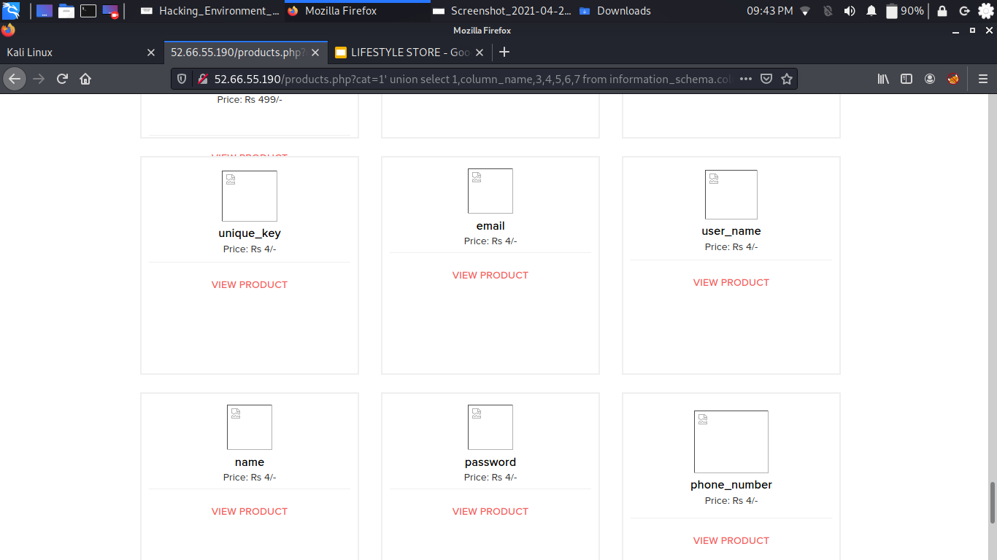
PoC: Attacker can dump arbitrary data
Manual approach have been done to find column names existence using following commands in url:
http://52.66.55.190/products.php?cat=1' union select 1,column_name,3,4,5,6,7 from information_schema.columns where table_schema="hacking_training_project" and table_name="users"--+
Column name in table name “users”
id
type
unique key
email
username
name
password
phone _number
address
created_at
last_updated_at

Slide 14
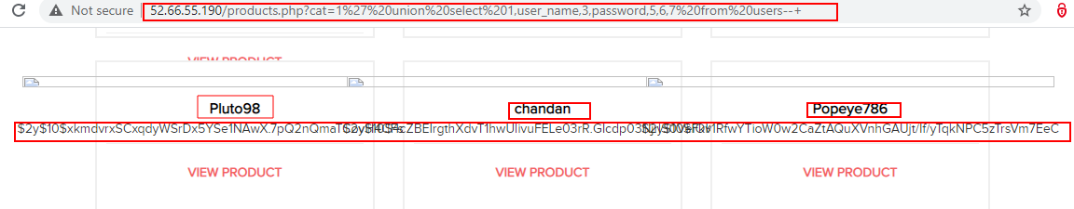
PoC: Attacker can dump arbitrary data
Manual approach have been done to find out user_name and password details from users tables.
http://52.66.55.190/products.php?cat=1' union select 1,user_name,3,password,5,6,7 from users--+

Slide 15
Business Impact – Extremely High
Using this vulnerability, attacker can execute arbitrary SQL commands on Lifestyle store server
and gain complete access to internal databases along with all customer data inside it.
Previous slide has the screenshot of users table which shows user credentials being leaked that too in plain text without any hashing/encryption.
Attacker can use this information to login to admin panels and gain complete admin level access
to the website which could lead to complete compromise of the server and all other servers connected to it.

Slide 16
RECOMENDATIONS
Sanitise user input and remove or encode special characters like ‘ “ - () # etc.
Use whitelist filters, which means if a parameter is supposed to have integer values, do not allow non-numeric input. If it is an email field, allow alphanumerics, @ and .(dot)
Use strong web application firewalls to make exploitation difficult
Use prepared statements for SQL queries instead of inserting user controlled input into SQL queries
Remove default databases and accounts such as test, guest, admin, etc.
References
https://www.owasp.org/index.php/SQL_Injection
https://en.wikipedia.org/wiki/SQL_injection

Slide 17
2.Access to admin panel
Access to admin panel
(critical)
The given below URL is vulnerable to Arbitrary File Upload and making other site admin high level complete changes.
Affected URL:
http://52.66.55.190/wondercms/home
http://52.66.55.190/wondercms/loginURL

Slide 18
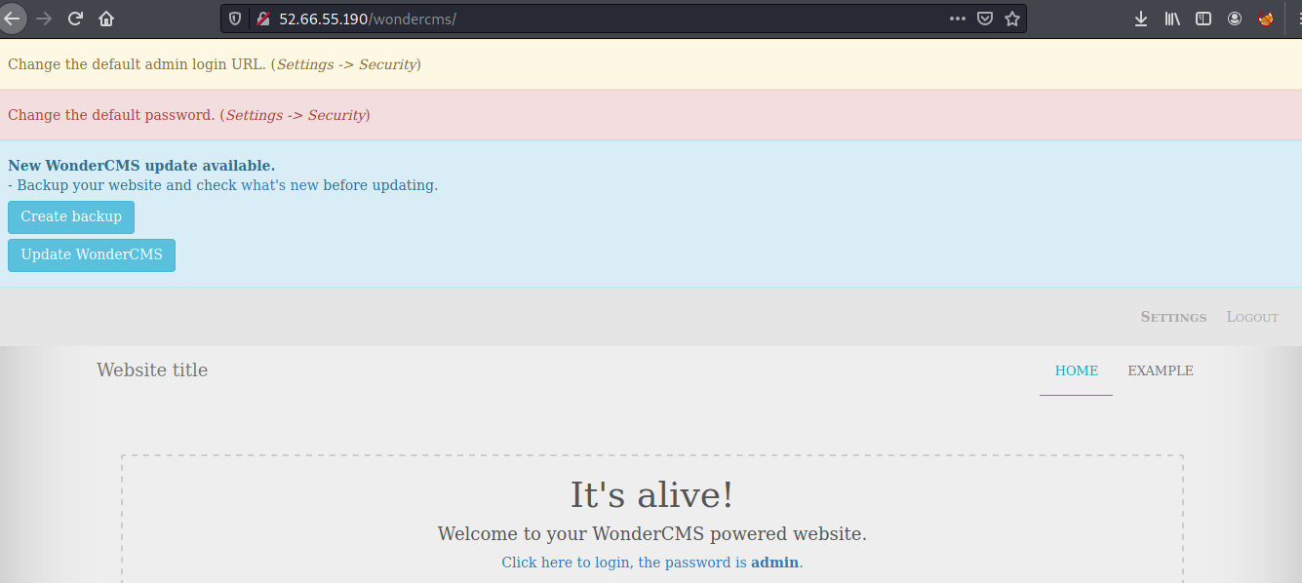
OBSERVATION
When we navigate to http://52.66.55.190/wondercms/home
we get the password on the above url homepage of wondercms ‘admin’ and login as : admin in the url :http://52.66.55.190/wondercms/loginURL

Slide 19
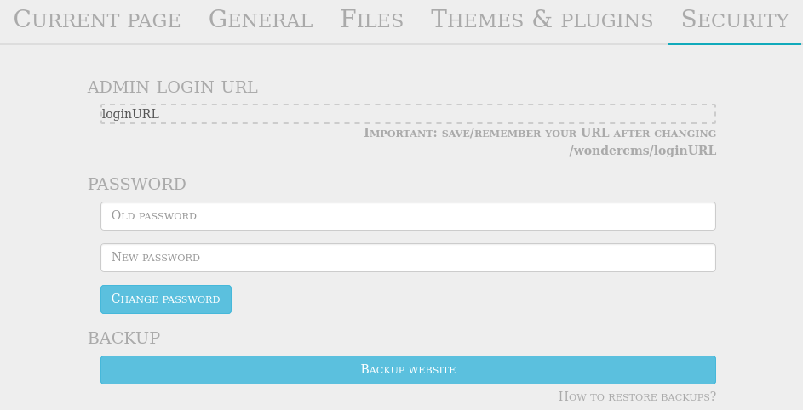
PROOF OF CONCEPT(POC)
Hacker can easily modify the admin password .
Hacker can also add and delete all pages.
Hacker can upload any malicious file or scriptshells.

Slide 20
Business impact -Extremely High
•Hacker can do anything with the page, he/she will have full access of the page and can use the page as well change according to it's will.
•It is the massive business risk.
•Loss can be very high to the lifestyle company.

Slide 21
RECOMMENDATIONS
•The default password should be changed and a strong password must be setup.
•The admin url must also be such that its not accessible to normal users.
•Password changing option must be done with 2 to 3 step verification such as mobile no. otp and email verification.
References:
•https://www.owasp.org/index.php/Default_Passwords
•https://www.us-cert.gov/ncas/alerts/TA13-175A
•https://www.cypressdatadefense.com/blog/password-security-risks/
•https://cwe.mitre.org/data/definitions/521.html

Slide 22
3.Arbitrary file uplaod
Arbitrary file upload(Critical)
The attacker can upload insecure shells and files and gain access over the entire database and login as the admin and the vesions known to have vulnerabilities .
Affected URL •http://52.66.55.190/wondercms/home/Affected Parameters
•File Upload (POST parameter)
The attacker can upload files with extension other than .jpeg .
Affected URL : •http://52.66.55.190/profile/2/edit/Affected Parameters •Upload Profile Photo (POST parameter)

Slide 23
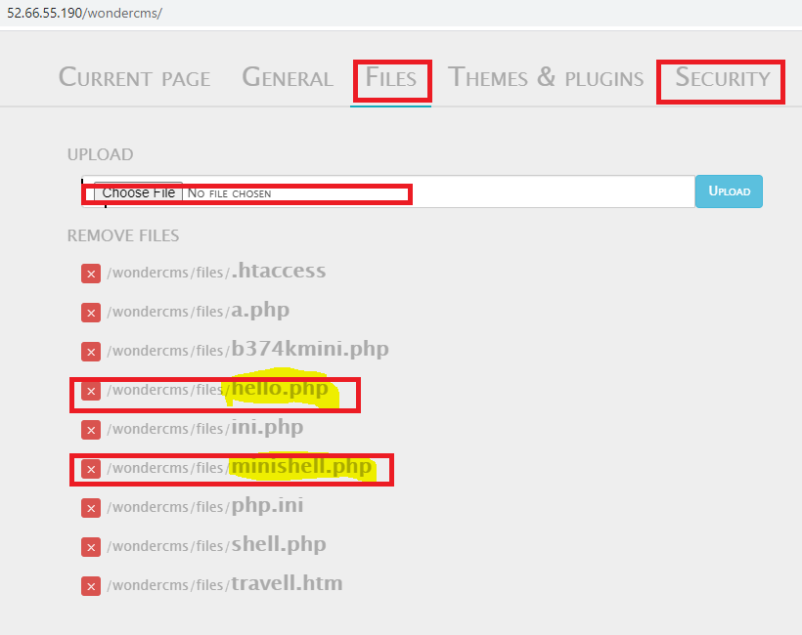
Observation

Slide 24
Proof of concept:-
•Weak password - admin.
•Arbitrary File Inclusion.

Slide 25
Business Impact – Extremely High
1.A malicious user can access the Dashboard which discloses many critical information of organization including:
• Important files of the company
• Passwords
•Admin access along with user access and details
• And many much more…
2.Any backdoor or shell can be uploaded to get access to the uploaded file on remote server and data can be exfiltrated. The presence of an actual malicious file can compromise the entire system leading to system takeover/ data stealing.

Slide 26
Recommendation
•Change the Admin password to something strong and not guessable.
•The application code should be configured in such a way, that it
should block uploading of malicious files extensions such as exe/ php
and other extensions with a thorough server as well as client
validation. CVE ID allocated:CVE-2017-14521.
References
https://owasp.org/www-community/vulnerabilities/Unrestricted_File_Upload
https://resources.infosecinstitute.com/topic/php-lab-file-upload-vulnerabilities/

Slide 27
Recommendation
Take the following precautions:
a strong password 8 character or more in length with alphanumerics and symbols
It should not contain personal/guessable information
Do not reuse passwords
Disable default accounts and users
Change all passwords to strong unique passwords
References:
https://www.acunetix.com/vulnerabilities/web/weak-password/
https://cwe.mitre.org/data/definitions/521.html
https://owasp.org/www-project-web-security-testing-guide/latest/4-Web_Application_Security_Testing/04-Authentication_Testing/07-Testing_for_Weak_Password_Policy

Slide 28
4. Account takeover using OTP bypass
Account takeover using OTP bypass
(critical)
The below mentioned login page allows login via OTP which can be bruteforced
Affected URL :
http://52.66.55.190/reset_password/admin.php
Affected Parameters :
OTP (POST parameters)

Slide 29
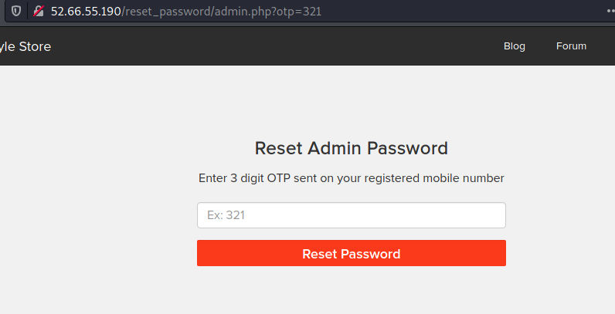
Observation
• Navigate to http://52.66.55.190/reset_password/admin.php?otp=321 . You will see user login page via OTP. We will bypass the otp by using Burpsuite tool by capturing otp parameter and setting payloads no. from 100 to 999.
This will tell the status code along with higher length size which the code is right.

Slide 30
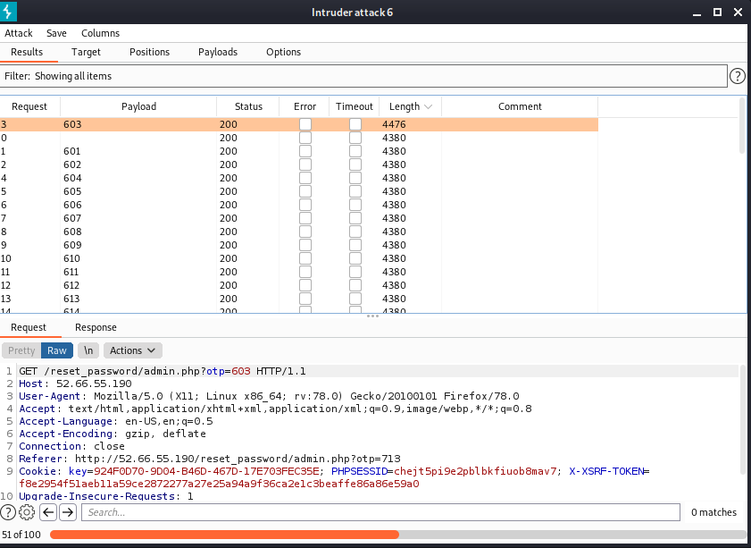
Observation
we easily got the valid otp

Slide 31
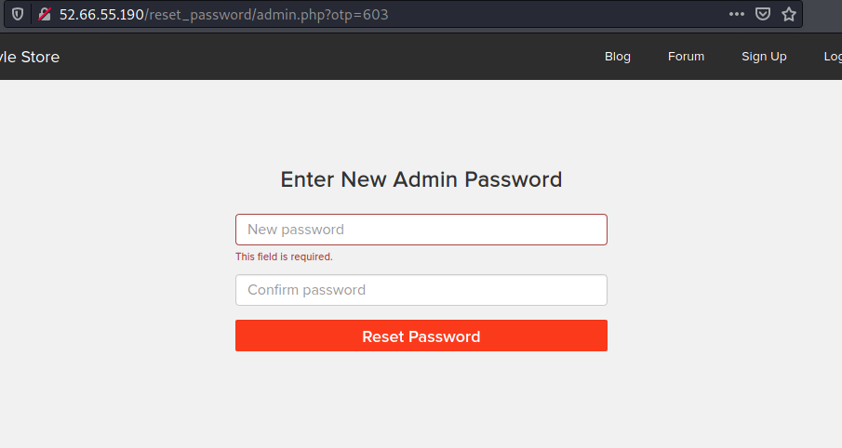
POC:
Hacker can easily change the password of admin dashboard.

Slide 32
Business Impact – Extremely High
A malicious hacker can gain complete access to any account just by brute forcing
the otp. This leads to complete compromise of personal user data of every customer.
Attacker once logs in can then carry out actions on behalf of the victim which could lead to serious financial loss to him/her.

Slide 33
Recommendation
Take the following precautions:
• Use proper rate-limiting checks on the no of OTP checking and Generation requests
• Implement anti-bot measures such as ReCAPTCHA after multiple incorrect attempts
• OTP should expire after certain amount of time like 2 minutes
• OTP should be at least 6 digit and alphanumeric for more security
References:
https://www.owasp.org/index.php/Testing_Multiple_Factors_Authentication_(OWASP-AT-009)
https://www.owasp.org/index.php/Blocking_Brute_Force_Attacks

Slide 34
5.CSRF
The below mentioned login page allows you to change password without verification and view
details of other customers (CSRF).
Affected URL :
•http://52.66.55.190/profile/change_password.php
Affected Parameters :
•Update button (POST parameter) We can change the password.
Affected URL :
•http://52.66.55.190/cart/cart.php
Affected Parameters :
•Remove option (POST parameter)
Affected URL :
•http://52.66.55.190/cart/cart.php
Affected Parameters :
•Confirm order option (POST parameter)
Unauthorised
Access to
Customer
Details(Critical)

Slide 35
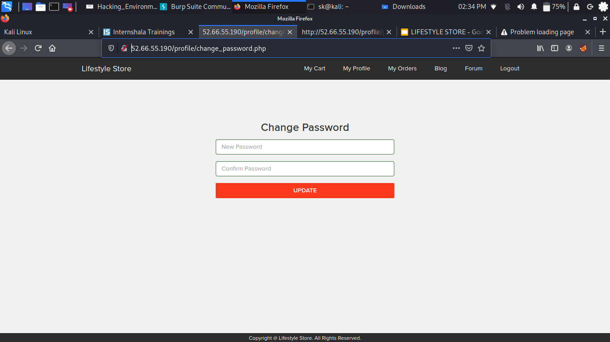
Observation
• Here you can see change password ,but due to csrf vulnerability I'll change the password at the moment he want to update.

Slide 36
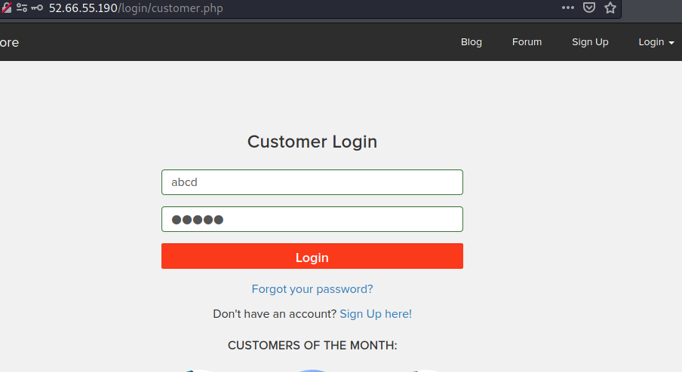
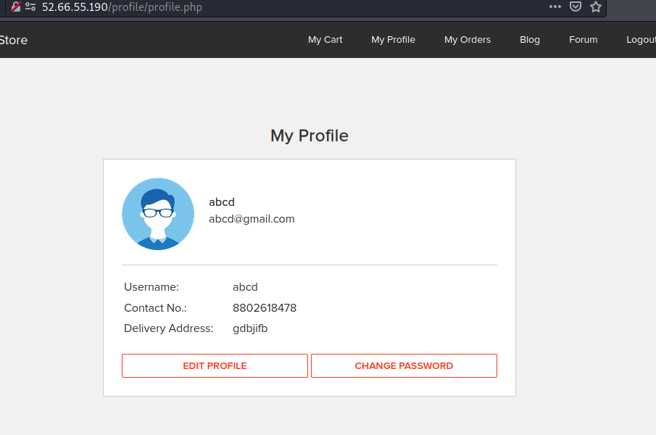
Observation
• Here's the file I opened while chnaging password , when we click on send the password will
change to 54321.

Slide 37
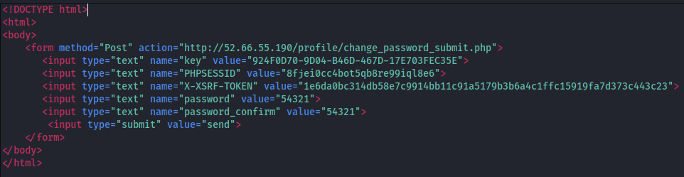
POC
Here's the code of generated by burp suite community edition.

Slide 38
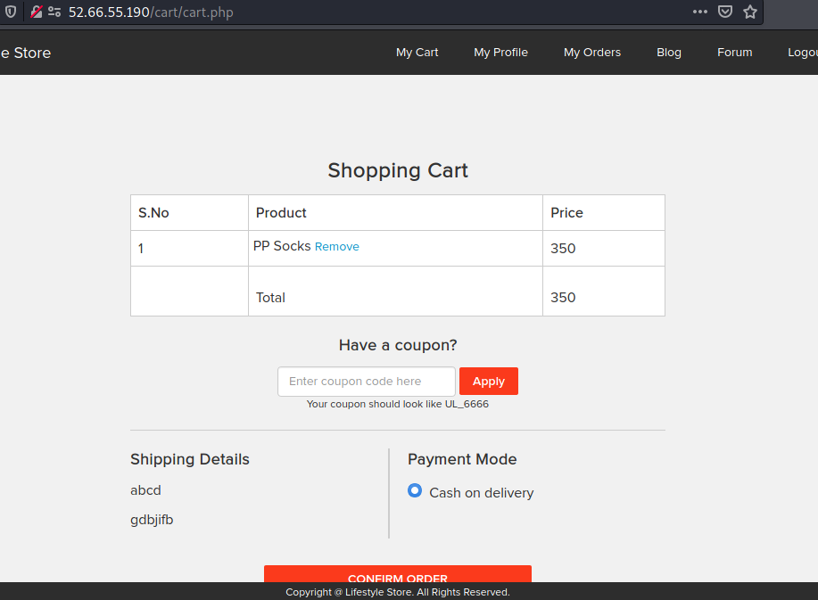
Observation
CSRF in cart

Slide 39
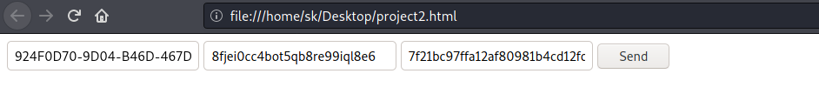
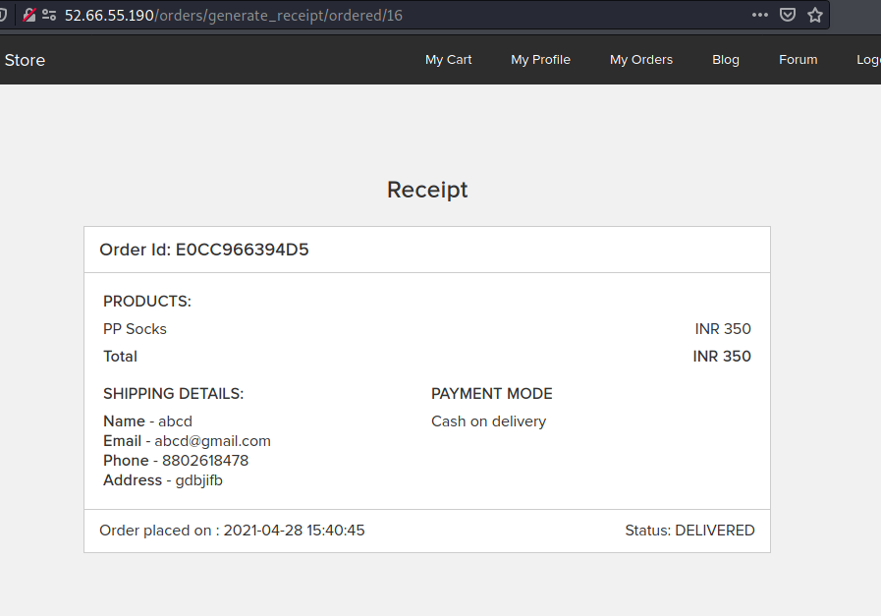
Observation
•The unwanted order has been placed by the user which he/she has stored in his/her cart.

Slide 40
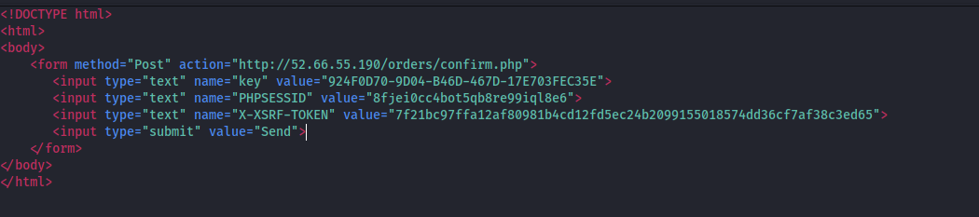
POC
Code analysed by me in burpsuite to write HTML code for csrf.

Slide 41
Business Impact – Very High
Hacker can change the password of any user .
Hacker can make user to do unwanted things.
It makes very bad impact of the website in the front of user.
Hacker can remove and confirm orders in the cart of the user.

Slide 42
Recommendation
Take the following precautions:
•Scan regularly
•Use anti-CSRF tokens
•Use the Same Site Flag in Cookies.
•Check the source of request made.
•Take some extra keys or tokens from the user before processing an important request.
•Use 2 factor confirmations like otp , etc. for critical requests.
References:
https://www.acunetix.com/websitesecurity/csrf-attacks/
https://owasp.org/www-community/attacks/csrf
https://www.netsparker.com/blog/web-security/csrf-cross-site-request-forgery/

Slide 43
6.Reflected Cross Site Scripting (XSS)
Reflected
Cross Site
Scripting(Severe)
Below mentioned parameters are vulnerable to reflected XSS
Affected URL :
• http://52.66.55.190/profile/16/edit/
Affected Parameters :
• address(POST parameters)
SCRIPT:
• <script>alert(1234567)</script>

Slide 44
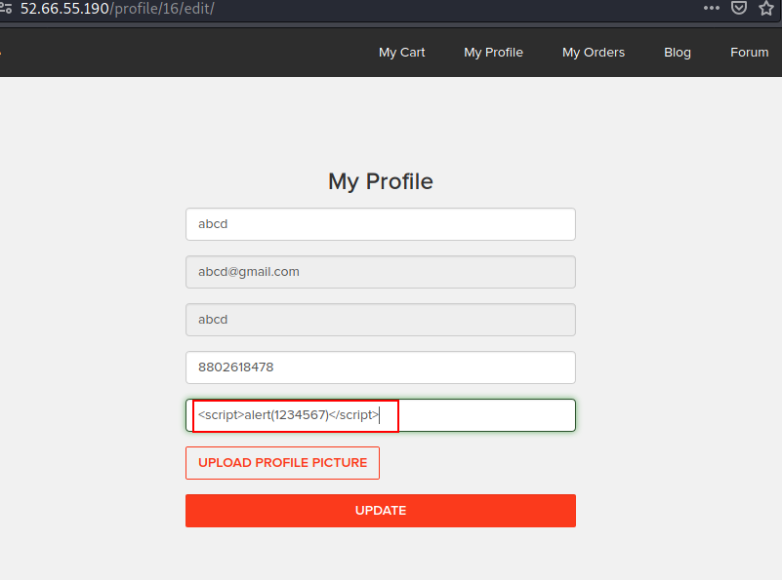
Observation
Open edit profile url and write down a script in the address bar.

Slide 45
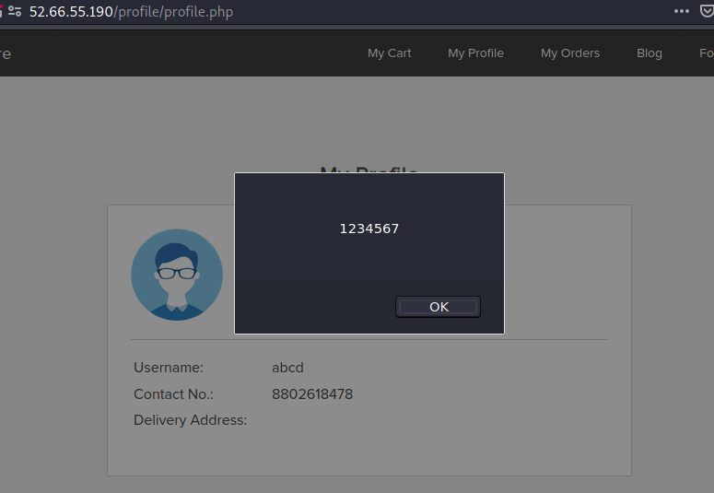
POC
The script is executed which has been written in the addess bar of the profile edit.

Slide 46
Business impact - High
As attacker can inject arbitrary HTML CSS and JS via the URL, attacker can put any content on the page like phishing pages, install malware on victim’s device and even host explicit content that could compromise the reputation of the organization.
All attacker needs to do is send the link with the payload to the victim and victim would see hacker controlled content on the website. As the user trusts the website, he/she will trust the content.

Slide 47
Recommendation
Take the following precautions:
• Sanitize all user input and block characters you do not want
• Convert special HTML characters like ‘ “ < > into HTML entities &quot; %22 &lt; &gt; before
printing them on the website
References:
https://www.acunetix.com/websitesecurity/cross-site-scripting/
https://portswigger.net/web-security/cross-site-scripting
https://owasp.org/www-community/attacks/xss/

Slide 48
7.Stored Cross Site Scripting (XSS)
Stored Cross
Site Scripting
(severe)
Below mentioned parameters are vulnerable to reflected XSS
Affected URL :
• http://52.66.55.190/products/details.php?p_id=17
Affected Parameters :
• POST button under Customer Review (POST parameters)
Payloads:
• <script>alert('this site is Hacked')</script>
• <script>alert('Hacked')</script>
• <h1>hello</h1>

Slide 49
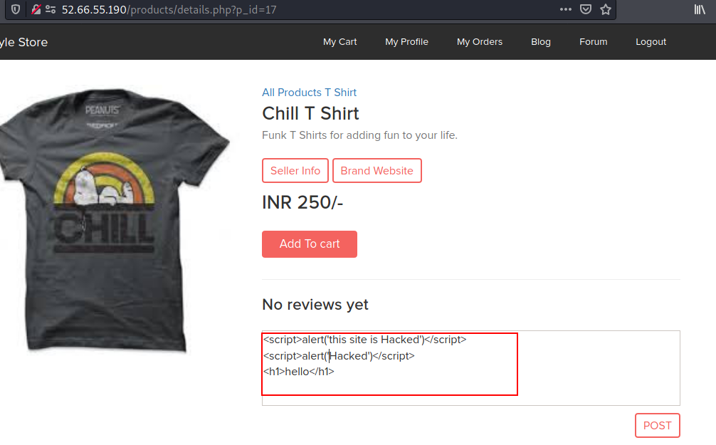
Observation
Now try entring the payload in review box

Slide 50
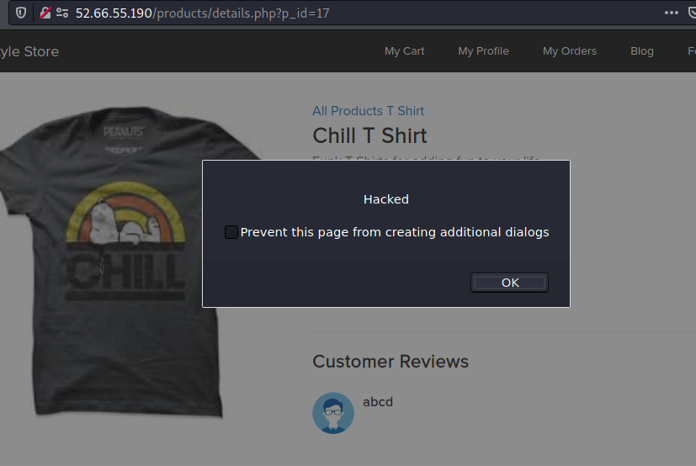
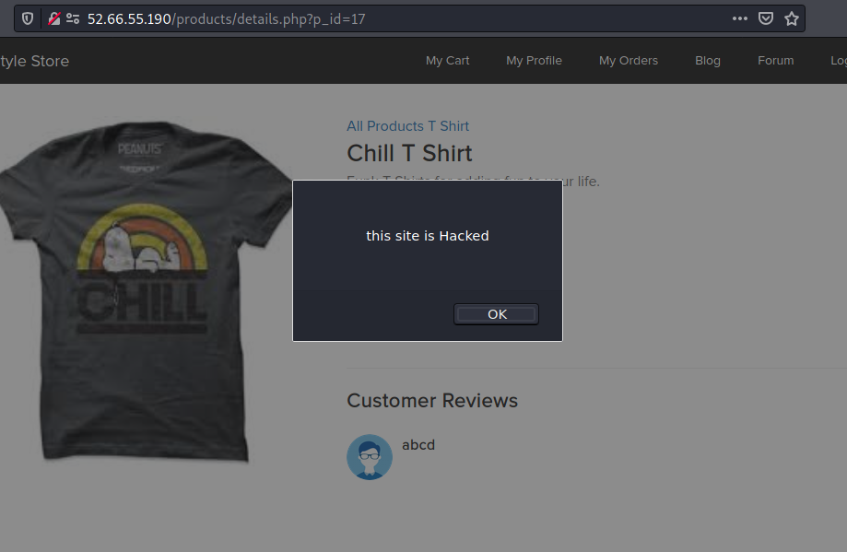
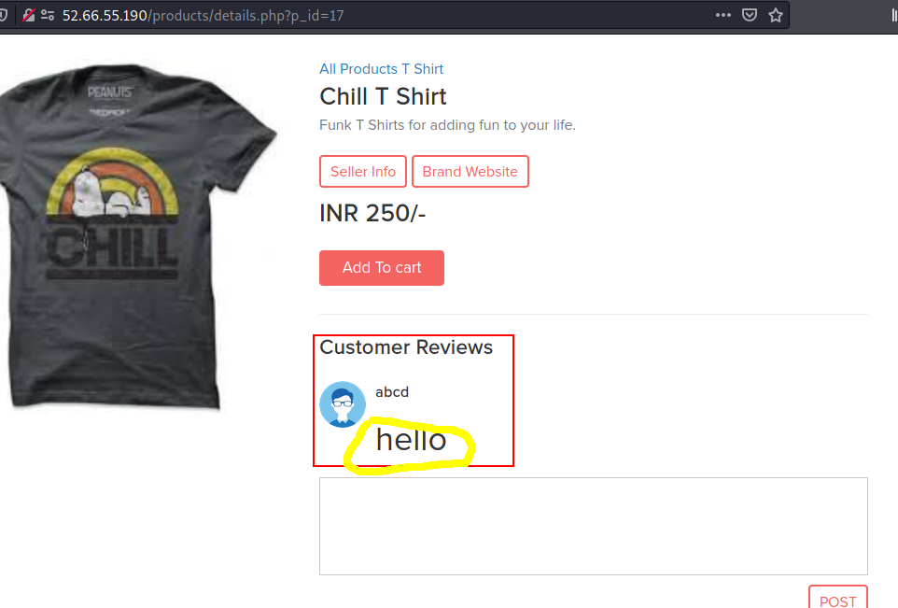
POC

Slide 51
Business impact - High
As attacker can inject arbitrary HTML CSS and JS via the URL, attacker can put any content on the
page like phishing pages, install malware on victim’s device and even host explicit content that
could compromise the reputation of the organization
All attacker needs to do is send the link with the payload to the victim and victim would see hacker
controlled content on the website. As the user trusts the website, he/she will trust the content.

Slide 52
Recommendation
Take the following precautions:
• Sanitize all user input and block characters you do not want
• Convert special HTML characters like ‘ “ < > into HTML entities &quot; %22 &lt; &gt; before
printing them on the website
References:
https://portswigger.net/web-security/cross-site-scripting
https://www.owasp.org/index.php/Cross-site_Scripting_(XSS)
https://www.acunetix.com/websitesecurity/cross-site-scripting/

Slide 53
8.COMMON PASSWORD
Common
Password
(severe)
Below mentioned url has weak and very common password.
Affected URL :
• http://52.66.55.190/wondercms/loginURL

Slide 54
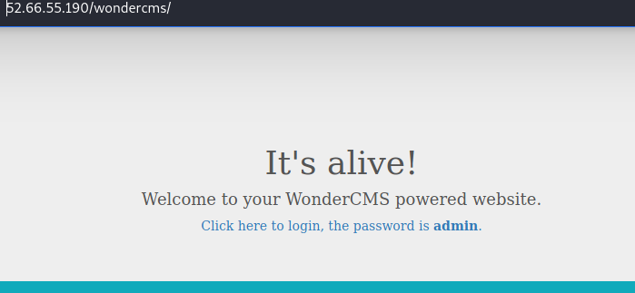
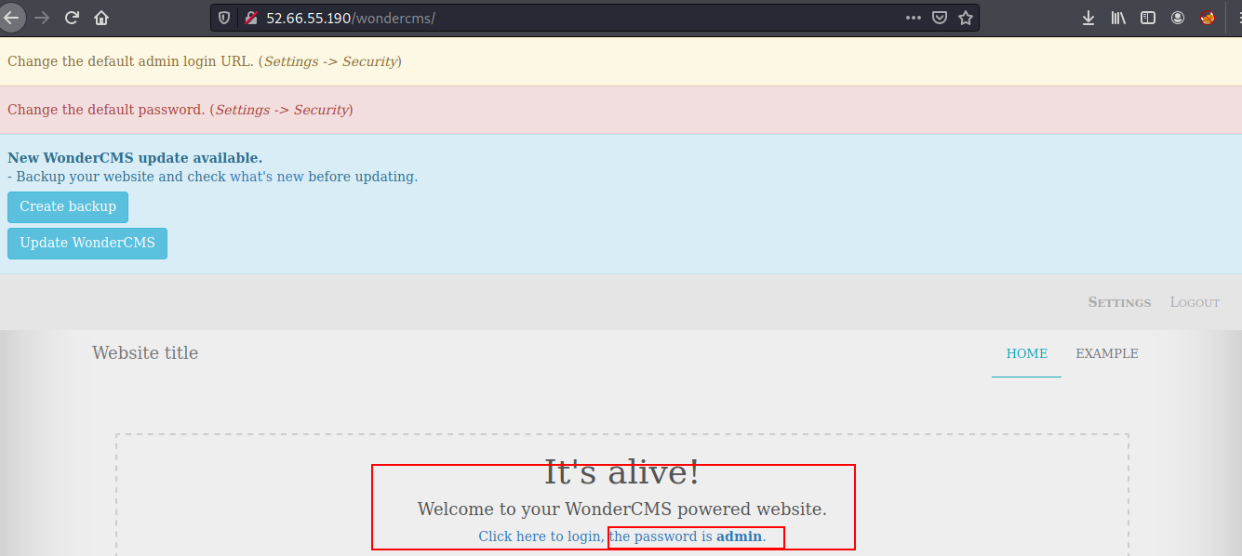
Observation
• Password is shown below .

Slide 55
Business Impact – high
Easy, default and common passwords make it easy for attackers to gain access to their accounts illegal use of them and can harm the website to any extent after getting logged into privileged accounts.

Slide 56
Recommendation
•There should be password strength check at every creation of an account.
•There must be a minimum of 8 characters long password with a mixture of numbers
, alphanumerics ,special characters ,etc.
•There should be no repetition of password ,neither on change nor reset.
•The password should not be stored on the web, rather should be hashed and stored.
References:
https://cheatsheetseries.owasp.org/cheatsheets/Authentication_Cheat_Sheet.html
https://www.acunetix.com/blog/articles/weak-password-vulnerability-common-think/
https://www.owasp.org/index.php/Testing_for_Weak_password_policy_(OTG-AUTHN-007)

Slide 57
9.Component with known vulnerability
Component
with known
Vulnerability
(severe)
•Server used is nginx/1.14.0 appears to be outdated (current is at least 1.17.3 ) i.e it is known to have exploitable vulnerabilities.
•WonderCMS
•Codoforum (Powered by codologic)

Slide 58
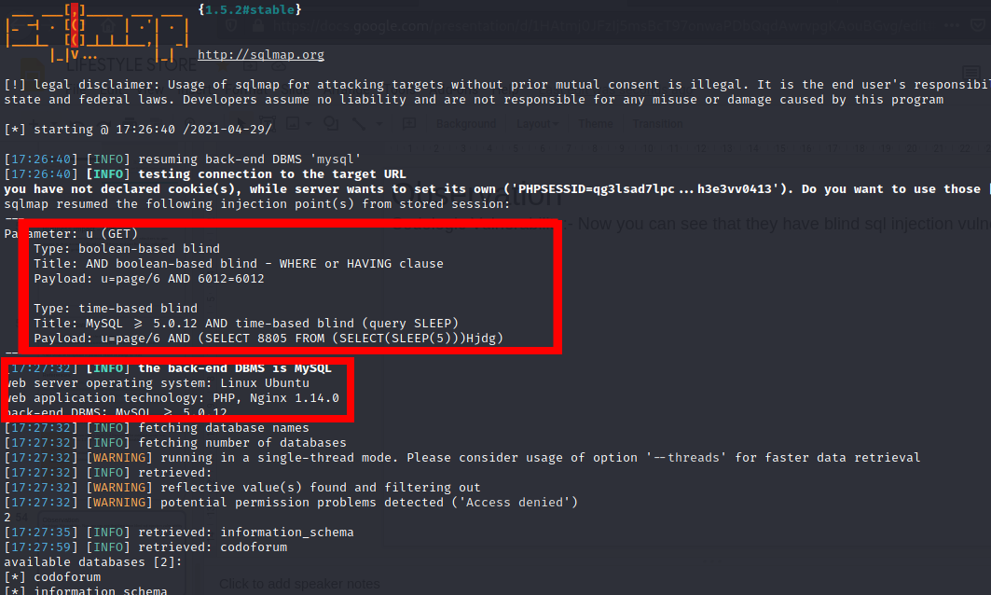
Observation
Codologic Vulnerability:- Now you can see that they have blind sql injection vulnerability

Slide 59
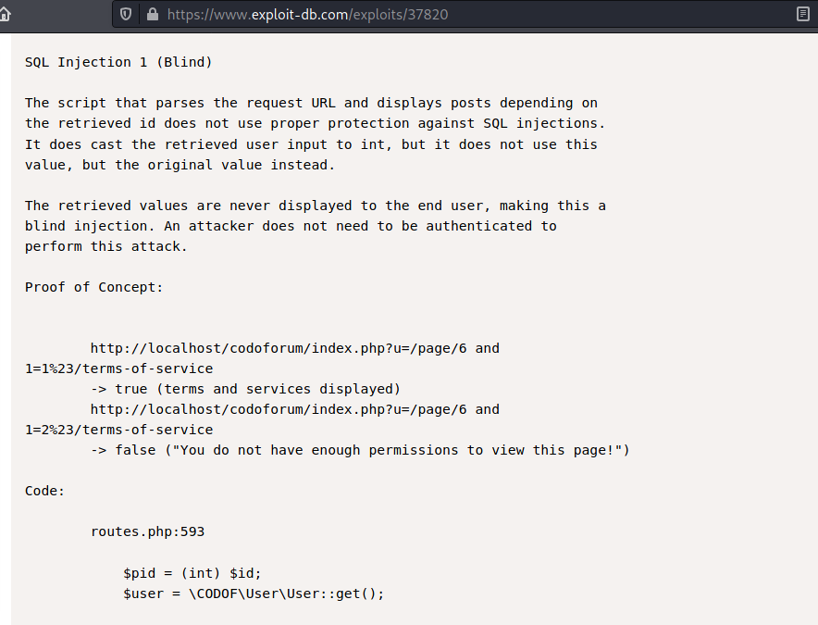
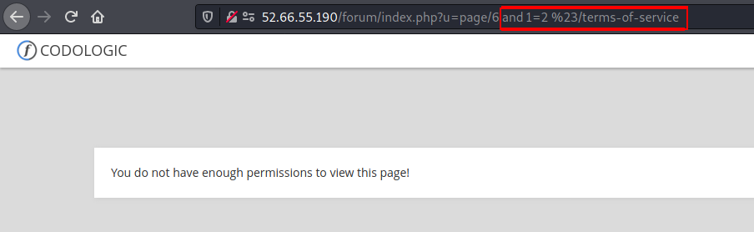
POC
Codologic Vulnerability,
It has multiple sql injection vulnerability,
given the link of exploit-db in reference.
And also given the manually approach
of blind SQL injection.

Slide 60
Business Impact – high
Exploits of every vulnerability detected is regularly made public and hence outdated software can very easily be taken advantage of.If the attacker comes to know about this vulnerability ,he may directly use the exploit to take down the entire system, which is a big risk.

Slide 61
Recommendation
•Upgrade to the latest version of Affected Software/theme/plugin/OS which means latest version.
•If upgrade is not possible for the time being, isolate the server from any other critical data and servers.
References:
https://usn.ubuntu.com/4099-1/
https://www.exploit-db.com/exploits/37820

Slide 62
10.Server misconfiguration
Server misconfiguration
(Moderate)
Below mentioned url will show you the server related info.
URL
http://52.66.55.190/server-status/
http://52.66.55.190/server-info/

Slide 63
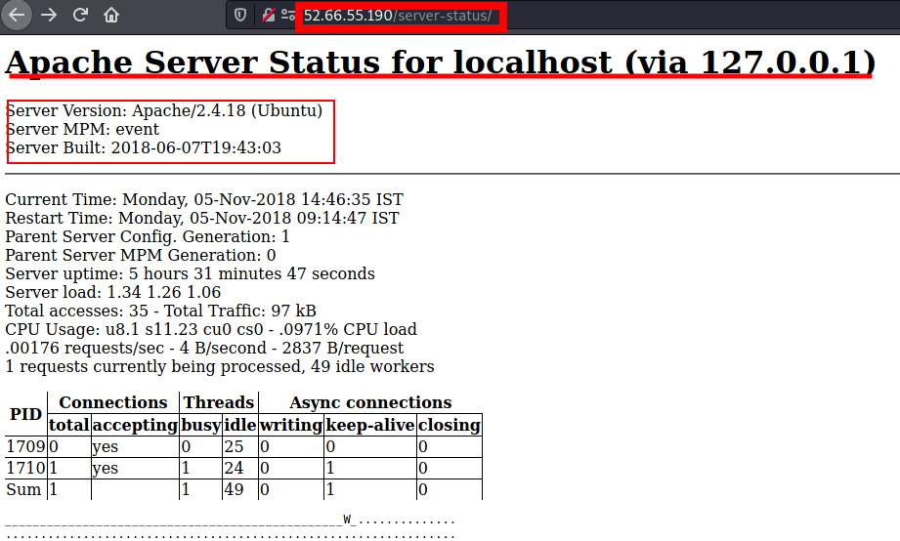
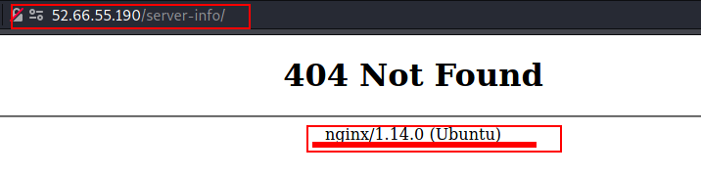
Observation and POC

Slide 64
Recommendation
Keep the software up to date
Disable all the default accounts and change passwords regularly
Develop strong app architecture and encrypt data which has
sensitive information.
Make sure that the security settings in the framework and libraries are set to secured values.
Perform regular audits and run tools to identify the holes in the system
References:
https://www.whitehatsec.com/glossary/content/server-misconfiguration
https://hdivsecurity.com/owasp-security-misconfiguration

Slide 65
11.Unauthorized access to user details(IDOR)
Unauthorized access to user details
(Moderate)
Below mentioned url will have vulnerabilty through which anyone can see the details of another user
URL
http://52.66.55.190/orders/orders.php?customer=16
Affected parameter
customer=13
http://52.66.55.190/orders/orders.php?customer=13

Slide 66
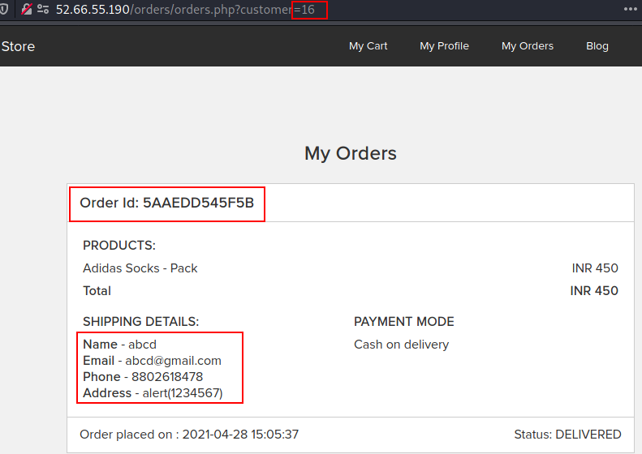
Observation
•When we change the payload we can see the reciepts of other users or customers.

Slide 67
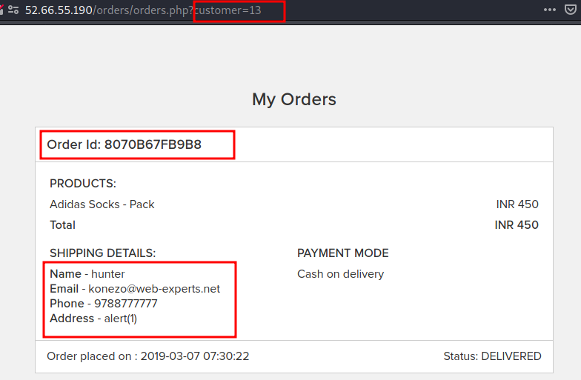
POC
•Here you can clearly see the receipt of another user

Slide 68
Business Impact – Extremely High
A malicious hacker can read bill information and account details of any user just by knowing the
customer id and User ID. This discloses critical billing information of users including:
•Mobile Number
•Bill Number
•Billing Period
•Total number of orders ordered by customer
•Bill Amount and Breakdown
•Phone no. and email address
•Address
This can be used by malicious hackers to carry out targeted phishing attacks on the users and the information can also be sold to competitors/blackmarket. More over, as there is no ratelimiting checks, attacker can bruteforce the user_id for all possible values and get bill information of each and every user of the organization resulting is a massive information leakage.

Slide 69
Recommendation
Take the following precautions:
•Implement proper authentication and authorisation checks to make sure that the user has permission to the data he/she is requesting
•Use proper rate limiting checks on the number of request comes from a single user in a small amount of time
•Make sure each user can only see his/her data only.
References
• https://www.owasp.org/index.php/Insecure_Configuration_Management
•https://www.owasp.org/index.php/Top_10_2013-A4-Insecure_Direct_Object_References

Slide 70
12.Directory Listings
Directory Listings
(Moderate)
Below mentioned some urls disclose server information.
Affected URL :
http://52.66.55.190/phpinfo.php
http://52.66.55.190/robots.txt
http://52.66.55.190/userlist.txt
http://52.66.55.190/composer.lock

Slide 71
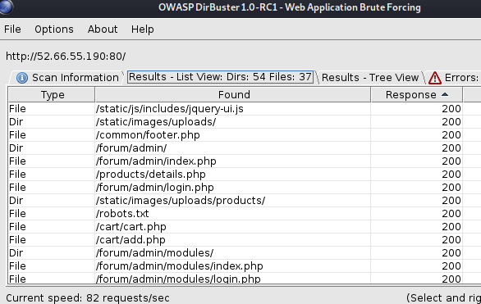
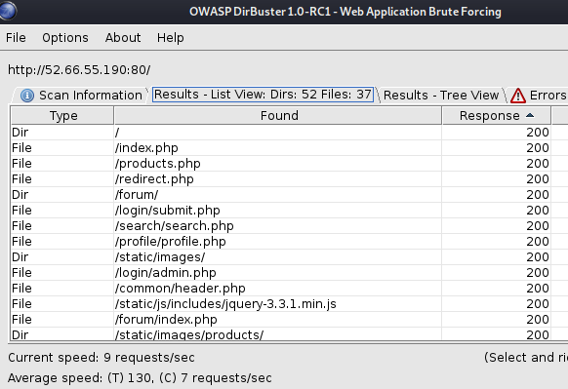
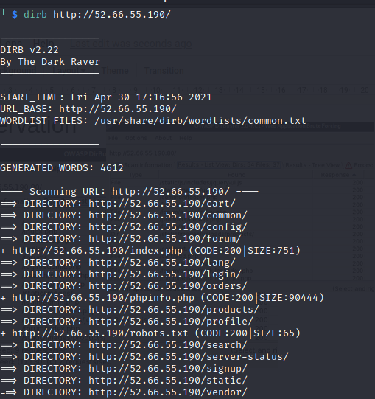
Observation

Slide 72
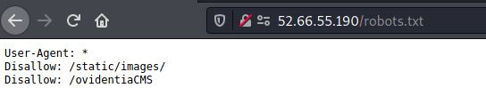
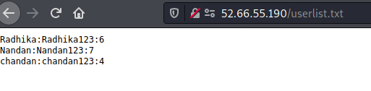
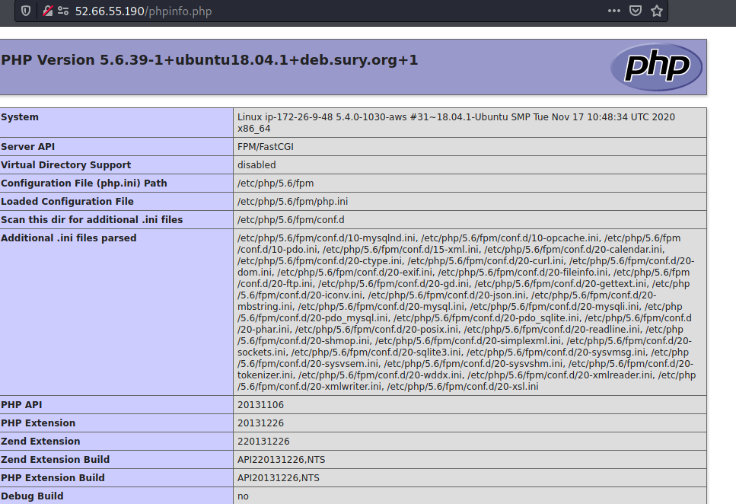
POC

Slide 73
POC
In above observation you can see that a hacker can go through these directory easily and gather as much as information he/she want.
Infact it also shows some accounts of seller

Slide 74
•Although this vulnerability does not have a direct impact to users or the server, though it can aid the attacker with information about the server and the users. Information Disclosure due to default pages are not exploitable in most cases, but are considered as web application security issues because they allows malicious hackers to gather relevant information which can be used later in the attack lifecycle, in order to achieve more than they could if they didn’t get access to such information.
Business Impact – Moderate

Slide 75
Recommendation
Disable all default pages
Enable multiple security checks
References
https://www.netsparker.com/blog/web-security/information-disclosure-issues-attacks/
https://www.netsparker.com/web-vulnerability-scanner/vulnerabilities/information-disclosure-phpinfo/

Slide 76
13.Personal Information Leakage
Personal Information Leakage(Low)
Below mentioned urls disclose personal inforamtion
Affected URL :
http://52.66.55.190/static/images/customers/default.png
http://52.66.55.190/static/images/customers/

Slide 77
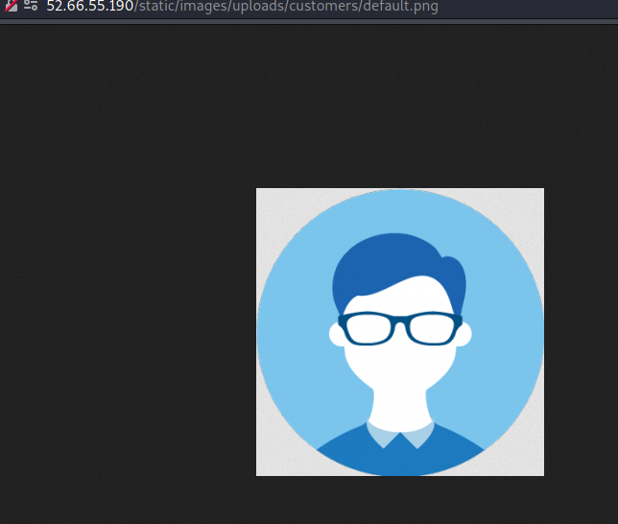
Observation
• Navigate to mentioned URL
• And you can see the whole path where everyones photo is stored

Slide 78
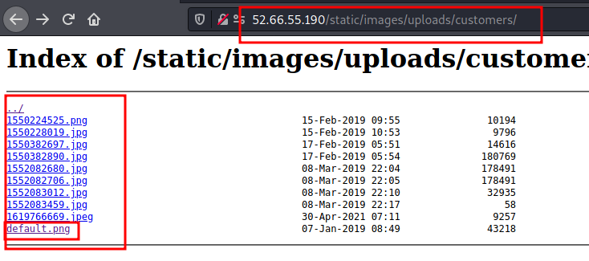
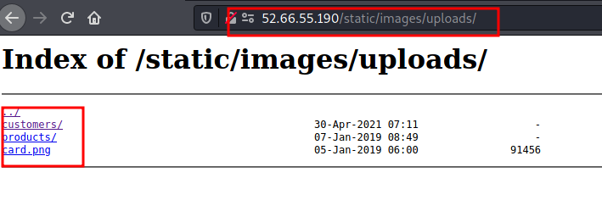
POC
• Here if you see the url , you
will know that we just
changed it little bit and we
hit jackpot where we can
see photos uploaded by
customer and may more...

Slide 79
Business Impact – Moderate
Although this vulnerability does not have a direct impact to users or the server, though it can help the attacker in mapping the personal information of any account and plan further attacks on any specific account.
Recommendations
• You can apply encyrption to the personal data
• You can add authenticity and authorization to access the other data
REFERENCES:-
https://cipher.com/blog/25-tips-for-protecting-pii-and-sensitive-data/
https://digitalguardian.com/blog/how-secure-personally-identifiable-information-against-loss-or-compromise

Slide 80
14.Client side and server side validation bypass
Client side and server side validation bypass(low)
In below mentioned urls , we can easily bypass client side and server side validation
Affected URL :
• http://52.66.55.190/profile/16/edit/
Affected parameter:
•Contact Number (POST Parameter)
Payload used:
1234567890000000

Slide 81
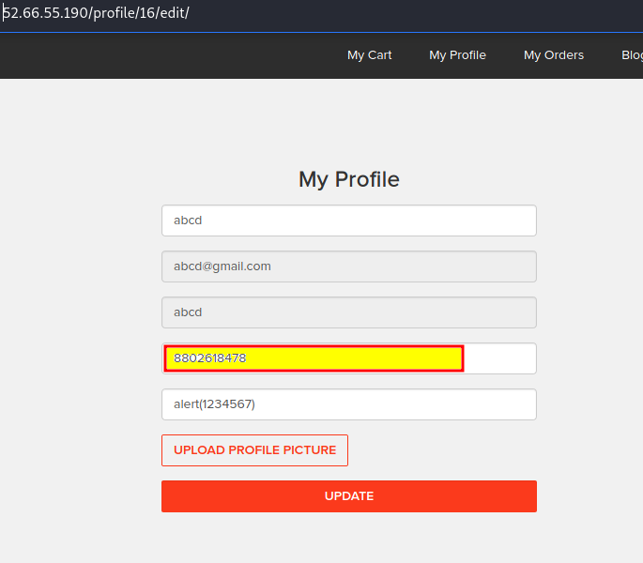
Observation
Here we intercepted the request and made changes in the contact number field

Slide 82
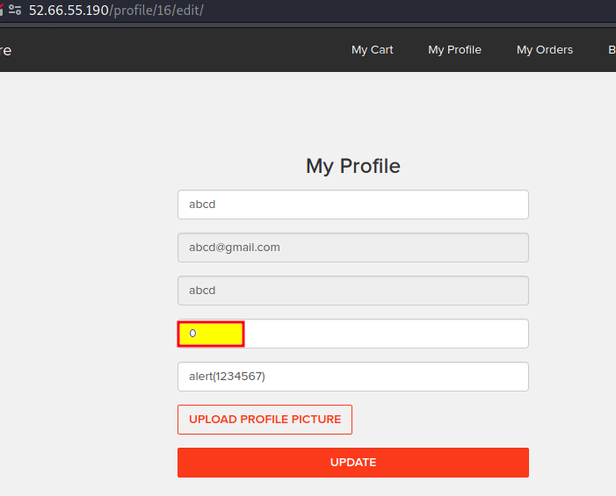
POC
•Mobile number is saved as zero

Slide 83
Business Impact – Moderate
The data provided by the user ,if incorrect, is not a very big issue but still must be checked for proper validatory information.
Recommendations
• Implement all critical checks on server side code only.
• Client-side checks must be treated as decoratives only.
• All business logic must be implemented and checked on the server code.
REFERENCES:-
http://projects.webappsec.org/w/page/13246933/Improper%20Input%20Handling
https://www.owasp.org/index.php/Unvalidated_Input

Slide 84
15.Default Messages
Default Messages(low)
In below mentioned urls ,if add a specific payload it will show deault messages
Affected URL :
•http://52.66.55.190/?includelang=lang/en.php
Payload:
en.php’(GET Parameter)

Slide 85
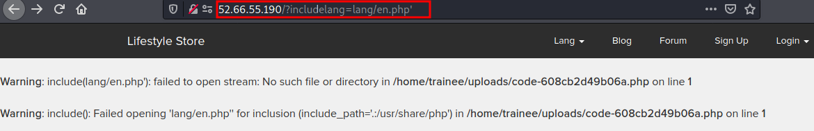
Observation & POC
we added payload as shown above and we got an error

Slide 86
Business Impact – Moderate
Although this vulnerability does not have a direct impact to users or the server, though it can help the attacker in mapping the server architecture and plan further attacks on the server.
Recommendations
• Do not display the default error messages because it not tells about the server but also sometimes about the location.So, whenever there is an error ,send it to the same page or throw some manually written error.
REFERENCES:-
https://www.owasp.org/index.php/Improper_Error_Handling

Slide 87
16.Open redirection
Open redirection
(low)
In below mentioned urls we can change the path of redirection
Affected URL :
http://52.66.55.190/?includelang=lang/en.php
http://52.66.55.190/?includelang=lang/fr.php
Payload:
http://52.66.55.190/?includelang=https://www.google.com/?lang/en.php

Slide 88
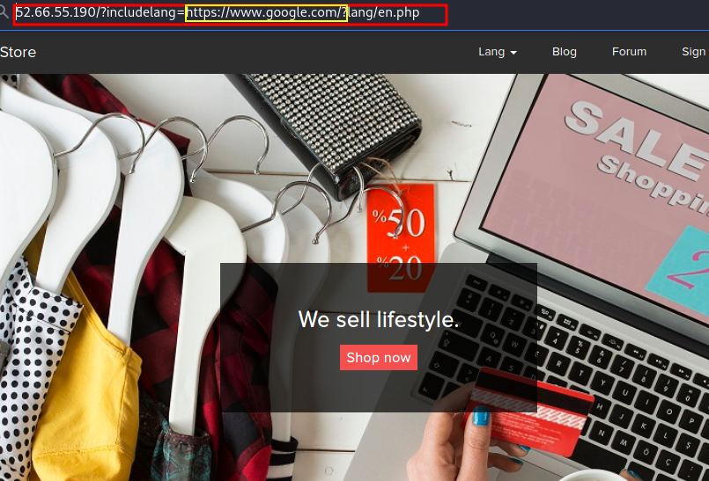
Observation
Here we made changes to the url according to the payload

Slide 89
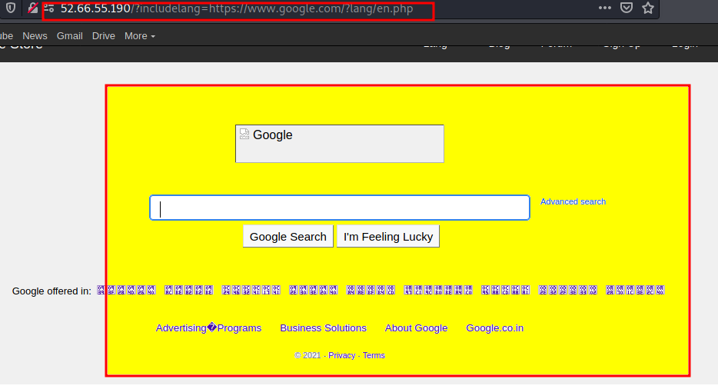
POC
We are redirected to google site.

Slide 90
Business Impact – low
An http parameter may contain a URL value and could cause the web application to redirect
the request to the specified URL. By modifying the URL value to a malicious site.
Recommendations
• Disallow Offsite Redirects.
• If you have to redirect the user based on URLs, instead of using untrusted input you should always use an ID
which is internally resolved to the respective URL.
• If you want the user to be able to issue redirects you should use a redirection page that requires the user to
click on the link instead of just redirecting them.
• You should also check that the URL begins with http:// or https:// and also invalidate all other URLs to prevent
the use of malicious URIs such as javascript:
REFERENCES:-
https://cheatsheetseries.owasp.org/cheatsheets/Unvalidated_Redirects_and_Forwards_Cheat_Sheet.html
https://docs.microsoft.com/en-us/aspnet/mvc/overview/security/preventing-open-redirection-attacks

Slide 91
THANK YOU
For any further clarifications/patch assistance, please contact:
8802618479

